Slide 1
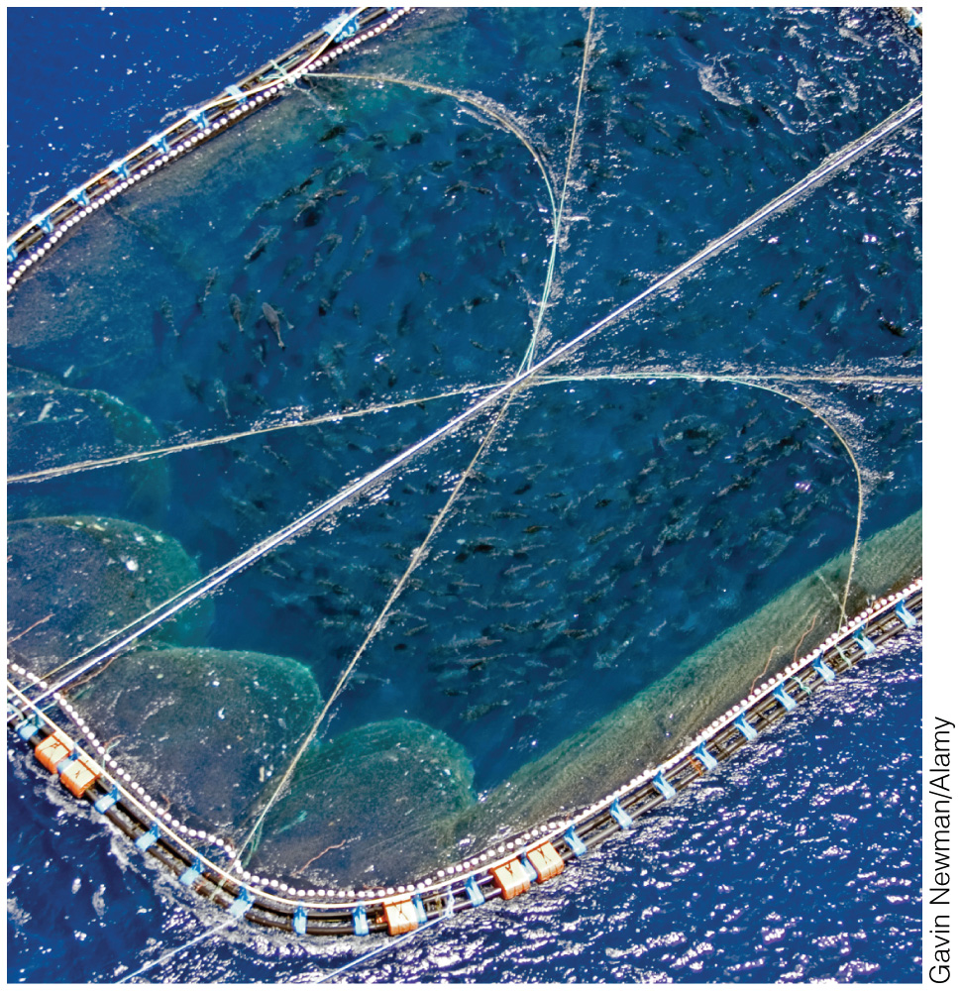
Sustainability and Human Values
Chapter B

Slide 2
A Sustainability Ethic
In 1962, Rachel Carson’s Silent Spring was published
In it, she questioned the wide scale application of pesticides on agricultural crops
Short term crop yield gains from pesticide use could undermine the availability of clean air, fresh water, and fertile soil in the long run
We need to consider trade-offs between short term gains and long term sustainability as global population continues to grow
Carson’s compelling description of the environment as a network of complex and interrelated systems is credited as a foundation of the modern environmental movement.

Slide 3
Human Use of the Earth
Sustainable development
Economic growth that meets the needs of the present without compromising the ability of future generations to meet their needs
Can occur only within the limits of the environment
The level of resource consumption found in highly developed countries, such as the US, Europe, and Japan, would not be sustainable if practiced globally

Slide 4
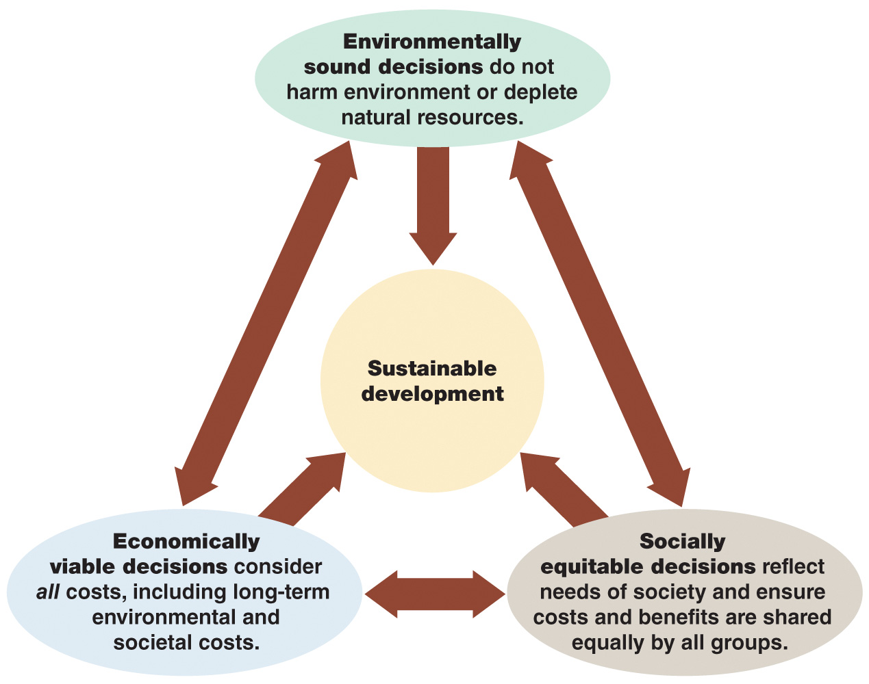
Human Use of the Earth
Sustainable Development
Three factors—environmentally sound decisions, economically viable decisions, and socially equitable decisions—interact to promote sustainable development.

Slide 5
Sustainable Consumption
Pollution and degradation of the environment increase with increasing resource consumption
Compared to more modest living situations, affluent lifestyles:
Use disproportionally more resources
Create disproportionally more pollution
Sustainable consumption is a balance between improving quality of life while reducing resource consumption
Influenced by population, economic activities, technology, social values, personal preferences, and government policies

Slide 6
Sustainable Consumption
At the global level, sustainable consumption requires the eradication of poverty
Consumption of essential resources by the global poor should increase, while consumption patterns of those in wealthy countries should decrease
Requires behavioral changes in people in highly developed countries

Slide 7
Sustainable Consumption
Voluntary simplicity:
Type of sustainable consumption where quality of life ≠ amount of material goods
Values and character define a person, not what they own
Includes car-sharing and using public transportation
Requires commitment at the individual level
Technological advances can help promote the acceptance of voluntary simplicity; for example: the development and availability of compact florescent light bulbs and LEDs

Slide 8
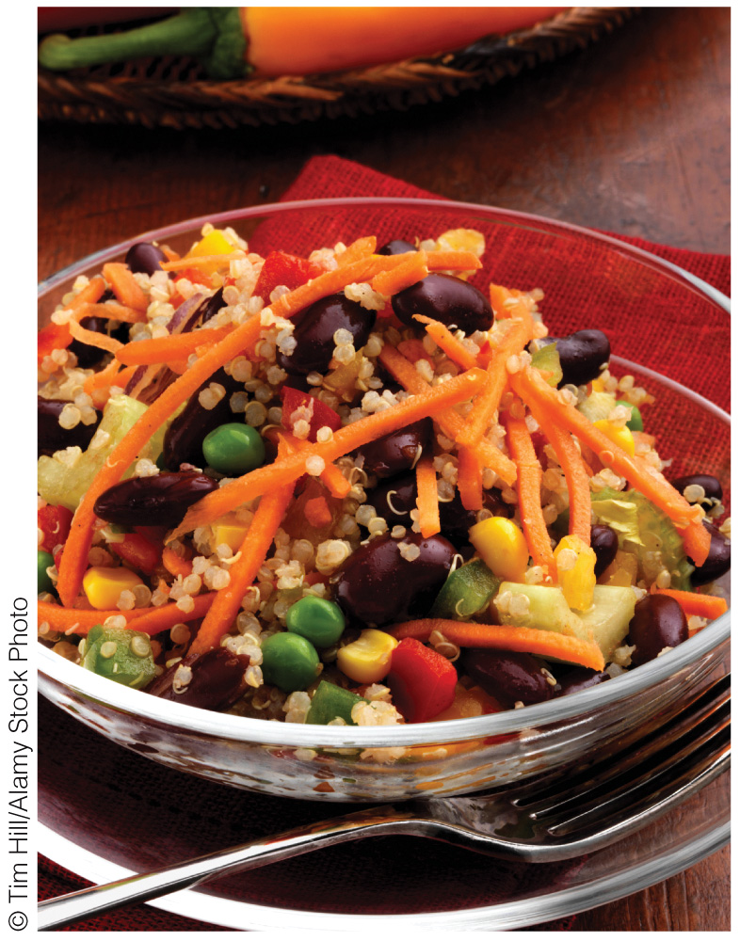
Human Values and Environmental Problems
Ethics is the branch of philosophy that deals with human values and morality
Environmental ethics considers the moral basis of environmental responsibility
Considers the rights of people living today AND of future generations
Critical because our actions today affect the environment in the future
Environmental ethics and food choice: What we choose to eat each day can impact the local and global environment. A meal that includes meat (a) usually utilizes more resources like fossil fuels, water, and land, than do vegetarian (b) or vegan (c) meals.

Slide 9
Worldviews
Worldview
Personal perspective based on our individual basic values
Help us make sense of the world and determine right and wrong behaviors
These behaviors are not necessarily compatible with environmental sustainability
Environmental Worldview
Based on how the environment works, our place in the environment, and right and wrong environmental behaviors

Slide 10
Worldviews
Western worldview (expansionist worldview)
Based on human superiority over nature
Unrestricted use of natural resources to fuel economic growth and expand the industrial base
Consistent with frontier attitude
Anthropocentric
Deep ecology worldview
Based on harmony with and respect for nature
All living things have equal worth
Biocentric

Slide 11
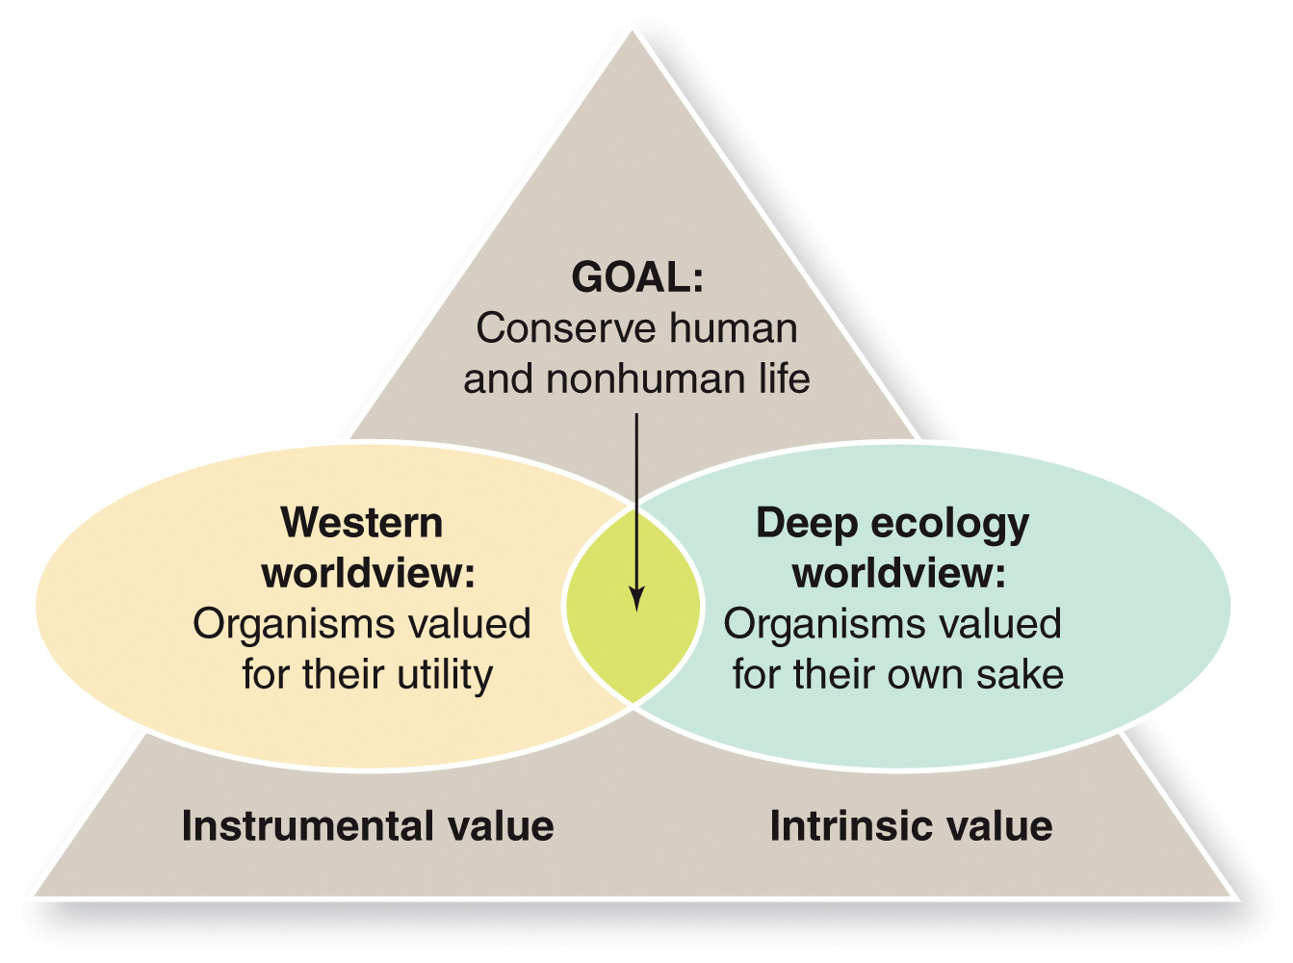
Worldviews
Intrinsic and Instrumental Values
According to the Western worldview, organisms have instrumental value—that is, they are valuable if they provide goods and services to humans. In contrast, according to the deep ecology worldview, organisms have intrinsic value—that is, they are valued for their own sake, not for the goods and services they provide.

Slide 12
Environmental Justice
Environmental Justice
The right of every citizen to adequate protection from environmental hazards
Eco-justice
Links social and environmental ethics
Low-income communities/minorities are more likely to be in polluted areas, and near landfills, toxic waste facilities, etc.
Tend to have lower access to health care
Rights of the poor and disenfranchised vs. the rights of rich and powerful

Slide 13
Environmental Justice and Ethical Issues
Environmental policy decisions have ethical dimensions
Whose rights have priority when siting an environmentally hazardous facility?
Finding and adopting equitable solutions to difficult environmental problems is challenging, but essential in an ethical society
We have a moral imperative to not repeat past environmental injustices
Advocates in many areas are calling for remediation of hazardous sites in areas of previous environmental injustice

Slide 14
An Overall Plan for Sustainable Living
Lester R. Brown, 2006. Plan B 2.0 Recusing a Planet Under Stress and a Civilization in Trouble
Eliminate poverty and stabilize the human population
Protect and restore Earth’s resources
Provide adequate food for all people
Mitigate climate change
Design sustainable cities

Slide 15
Eliminate Poverty and Stabilize
the Human Population
Global distribution of resources is uneven
The US, with 5% of world’s population, controls 25% of the world’s economy
However, the US depends on other nations for this prosperity
Globally, 16,000 infants and children under 5 die each day
Most of these deaths could be prevented with adequate food and basic medical care
Necessary to raise the standard of living of the world’s poor
Universal education of children
Eliminate illiteracy
Improving the status of women
Stay within the Earth’s carrying capacity

Slide 16
Protect and Restore Earth’s Resources
To build a sustainable society, we must preserve the natural systems that support us
Conservation of nonrenewable resources
Sustainable use of renewable resources
Forests
Unsustainable logging making them a non-renewable resource
Population pressure drives deforestation in many areas
Deforestation in developing countries occurring at a non-sustainable rate
Contributing to global climate change

Slide 17
Protect and Restore Earth’s Resources
Biodiversity: The number and variety of Earth’s organisms
5/6 of all species have yet to be described
80% species we depend on are found in developing countries
Loss of biodiversity results in loss of resources that global populations depend on for health and daily life
Organisms and the natural environment provide ecosystem services we need to survive
Protection of watersheds, agricultural lands, climate, habitats
Biological diversity and cultural diversity intertwined
Different languages, traditions and identities enrich the human experience

Slide 18
Provide Adequate Food for All People
Food insecurity
The condition in which people live with chronic hunger and malnutrition
Link between poverty and food insecurity
800 million people worldwide lack access to food needed to live healthy, productive lives
Mostly live in rural areas of developing countries
Improved agriculture is the highest priority for global sustainability
Multicropping
Conservation tillage
Aquaculture

Slide 19
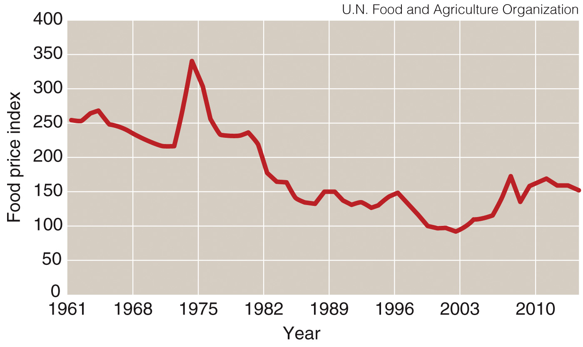
Provide Adequate Food for All People
Food volatility since 2002
From 1975 until the end of the last century, global food prices were mostly in decline
Beginning in 2002, food prices have been both increasing and are less predictable
Food price index
The price of food as compared to the price in 2002, adjusted for inflation

Slide 20
Mitigate Climate Change
Climate change caused by the enhanced greenhouse effect:
Additional warming produced by increased levels of gases that absorb infrared radiation
CO_{2 ,}methane, nitrous oxide, tropospheric ozone, CFCs
The most important greenhouse gas, CO₂, is produced when we burn fossil fuels
Current climate change is human induced, causing
Rapid warming since 1975
Shifted precipitation patterns
Rapid future changes in temperature and weather patterns

Slide 21
Mitigate Climate Change
No simple cause-and-effect relationship between an increase in atmospheric CO₂ and climate warming
Instead it is a cascade of interactions in the environment
Stabilizing the climate requires a comprehensive energy plan
Cut carbon emissions
Phase out fossil fuels
Improve energy efficiency
Also must stop and reverse rainforest destruction
Multinational commitment to plan

Slide 22
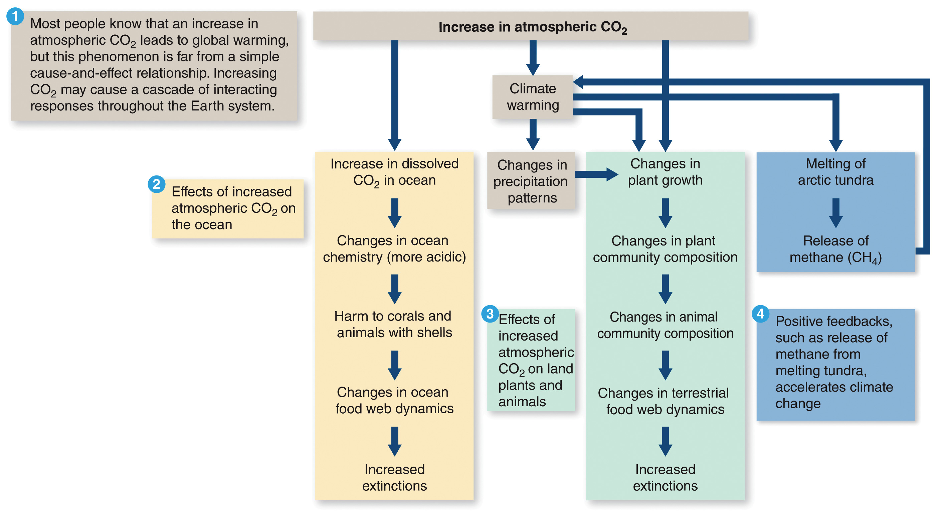
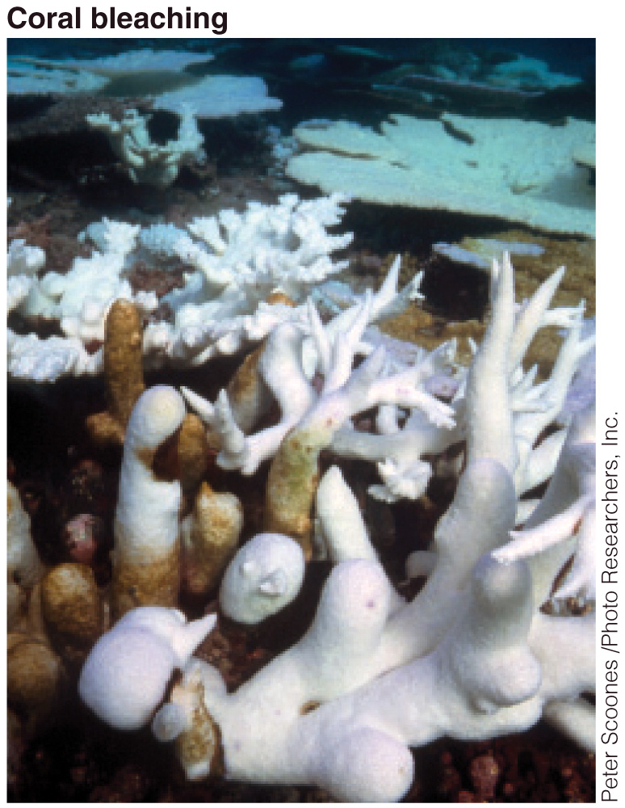
Mitigate Climate Change
Cascading Responses of Increased Carbon Dioxide Through the Environment

Slide 23
Design Sustainable Cities
Over 50% of world’s people live in cities
Over 80% of US and Canada’s populations live in cities
Making cities more livable
Urban transportation
Reduce use of cars
Develop subways, light rail systems, bicycle/pedestrian pathways
Build cities around people, not cars
Parks and open spaces instead of parking lots and highways
Reduces CO₂ emissions, air pollution, and improves quality of life
Address water scarcity
Improvement of squatter settlements
Address quality of life for the very poor

Slide 24
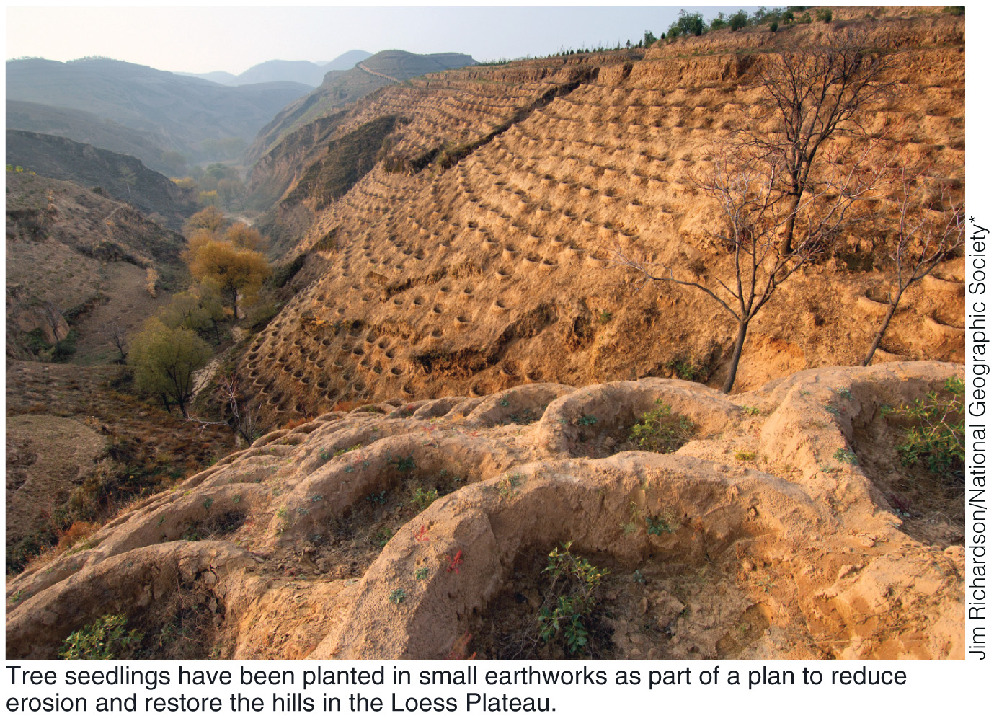
Case Study: Loess Plateau in China
Semiarid plateau suffered centuries of deforestation and overgrazing
Turned into nonproductive desert
In the past
Fertile agricultural soil
Important resource for China
Hope for the future
Loess Plateau Watershed Rehabilitation Project was established in 1994
As trees grow, erosion is improving
Less silt also runs into Yellow River
Tree seedlings have been planted in small earthworks as part of a plan to reduce erosion and restore the hills in the Loess Plateau

