Slide 1
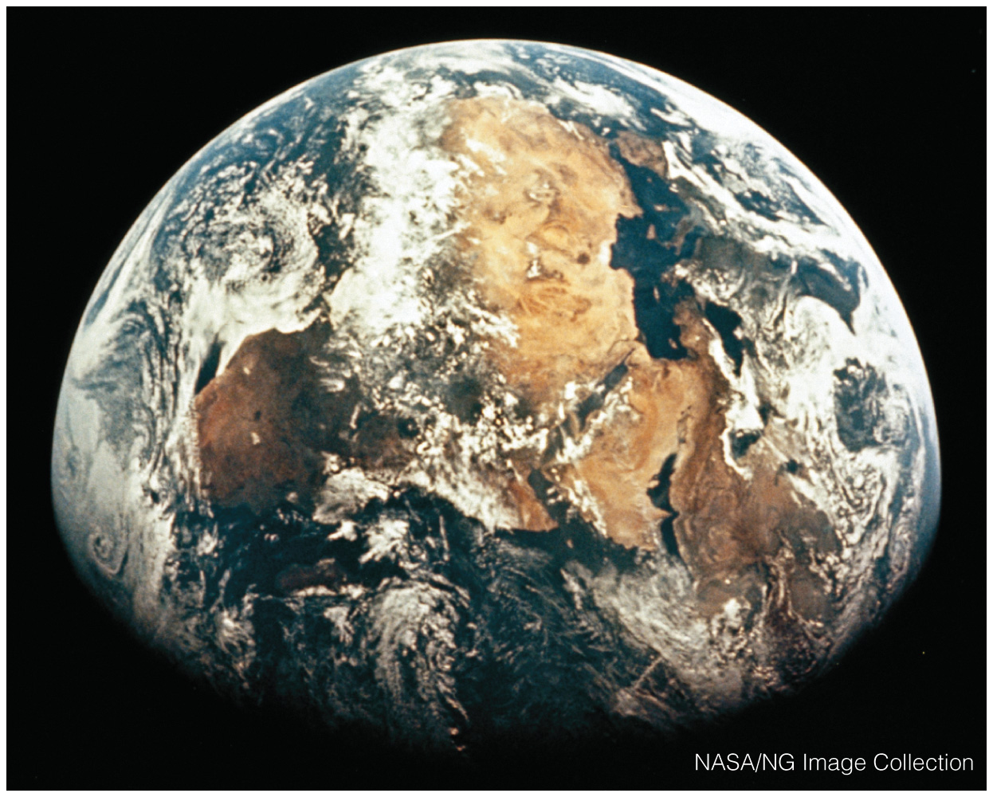
The Environmental Challenges We Face
Chapter A

Slide 2
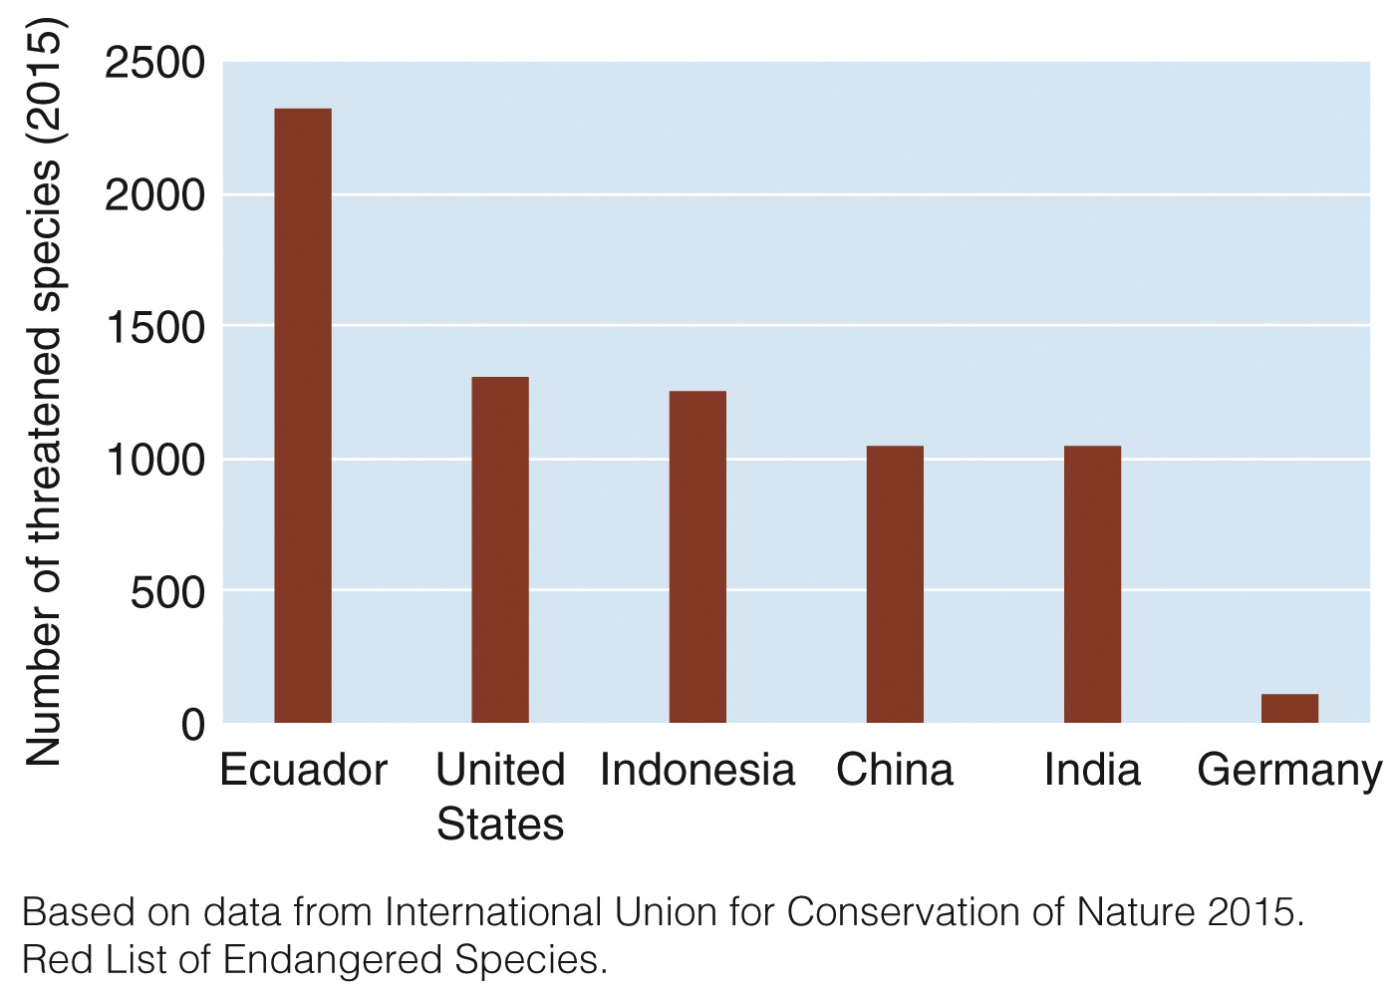
A Rapidly Changing World
Humans are the dominant agent of environmental change
Humans transform the landscape
Increasing populations are overwhelming Earth’s regenerative capacity
Human activities have:
Disrupted habitats of thousands of species
In 2015, a total of 22,784 species were classified as threatened worldwide
Profound effects on processes such as nutrient cycles and climate

Slide 3
Human Impacts on the Environment
Earth’s human population exceeded 7.3 billion in 2015
In 1960 = 3 billion; 1975 = 4 billion; 1987 = 5 billion
World population may stabilize by the end of the 21st century
Population experts project anywhere from 7.7 to 10.6 billion, depending on how rapidly the fertility rate decreases
Current average fertility rate worldwide is 2.5 children per woman
Fertility rates vary: 1.7 in highly developed countries compared to 4.5 in some of the least developed countries
Even with most countries’ active involvement with family planning, population growth rates take time to change

Slide 4
Human Impacts on the Environment
How many people the Earth can actually support is unknown
This will depend on our ability to develop sustainable agricultural practices that do not destroy the biological communities that support life on the planet
Consumption levels of materials and energy are also a factor
Globally, about 1.5 billion people live in poverty
A condition in which people are unable to meet their basic needs for food, clothing, shelter, or health
Poverty is associated with:
Short life expectancy
Illiteracy
Inadequate access to health services, safe water, and balanced nutrition

Slide 5
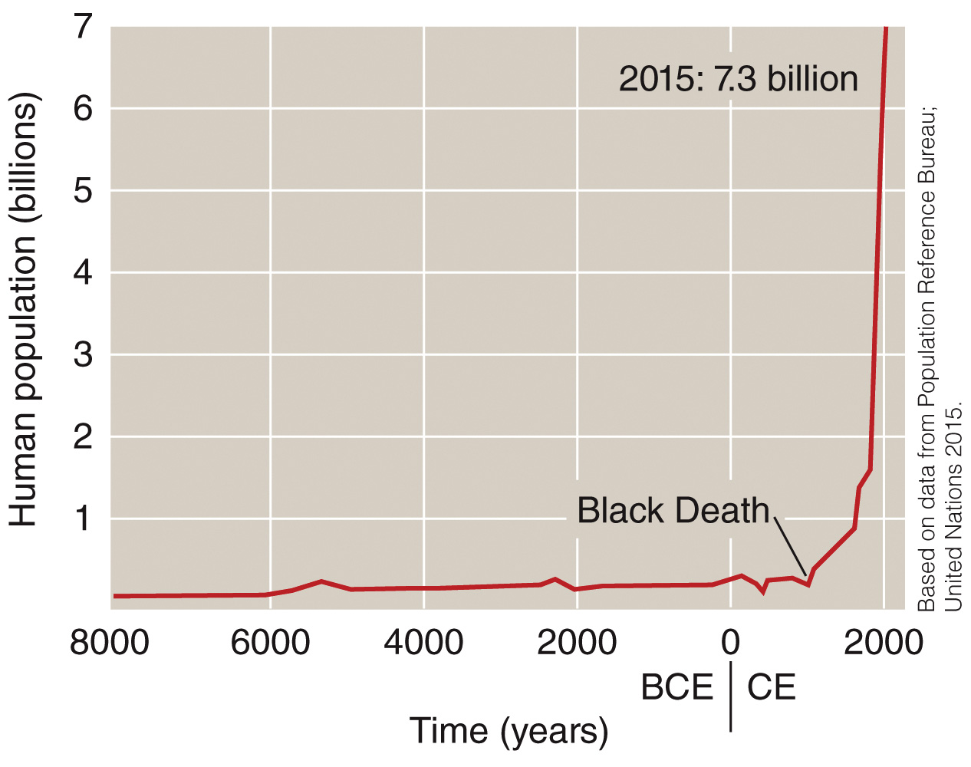
Human Impacts on the Environment
Human Population Growth
It took thousands of years for the human population to reach 1 billion (in 1800). In 2015, Earth’s human population surpassed 7 billion.

Slide 6
The Gap Between Rich and Poor Countries
Countries are divided into rich and poor
Rich countries are known as highly developed countries
Highly developed countries represent 18% of the world’s population (US, Canada, Japan)
They have complex industrialized bases, low rates of population growth, and high per person incomes.
People in highly developed countries consume more resources per person than people in developing countries

Slide 7
The Gap Between Rich and Poor Countries
Poor countries are known as moderately developed countries (MDCs) or less developed countries (LDCs)
82% of the world’s population live in either MDCs (such as Mexico, Turkey) or LDCs (such as Haiti, Bangladesh)
MDCs have:
Medium levels of industrialization
Lower per person incomes, and fewer opportunities for education and health care than those in highly developed countries

Slide 8
The Gap Between Rich and Poor Countries
LDCs have:
Very low per person incomes relative to those in highly developed countries
Low levels of industrialization, most economies are agricultural
High population growth rates
High infant mortality rates
Hunger, disease, and illiteracy are common

Slide 9
Population, Resources, and the Environment
The high rate of resource consumption in highly developed countries affects the environment as much as rapid population growth in other parts of the world
During rapid population growth, simply providing the essentials for survival can overwhelm a country’s natural resources
Often a situation found in developing countries
In highly developed countries, consumption of natural resources far exceeds amounts needed for basic survival
This depletion of resources extends past the boundaries of individual countries and can affect resources globally
Continued high-consumption lifestyles now rely on importation of resources from less developed countries to sustain them

Slide 10
Population, Resources, and the Environment
Types of resources:
Nonrenewable resources
Natural resources that are present in limited supplies and are depleted as they are used
Fossil fuels
Finite supply that took millions of years to form
Renewable resources
Resources that are replaced by natural processes and that can be used forever, provided they are not overexploited in the short term
Trees, soil, water
Potentially replaced by natural processes

Slide 11
Population, Resources, and the Environment
Population size and resource consumption:
At the same level of consumption, a larger population will consume more resources than a smaller one
However, globally, not all people consume the same amounts of resources
One child in a highly developed country has greater environmental impact than 20 children in a developing country
Highly developed nations represent less than 20% of the world’s population and consume more than half of the world’s resources:
86% of the aluminum used
76% of timber harvested
68 percent of energy produced
61% of meat eaten
42% fresh water consumed

Slide 12
Population, Resources, and the Environment
Ecological footprint:
Amount of productive land, fresh air/water, and ocean, required to supply one person with food, wood, energy, water, housing, clothing, transportation, and waste disposal
Allotted global footprint 4.3 acres
(Amount of Earth’s productive land and water ÷ Global human population)
Average global footprint 6.9 acres
This results in an ecological overshoot
Ecological footprints of countries (not individuals) vary depending on both population and consumption
France’s total footprint is 783.6 million acres
The US’s total footprint is 6943 million acres

Slide 13
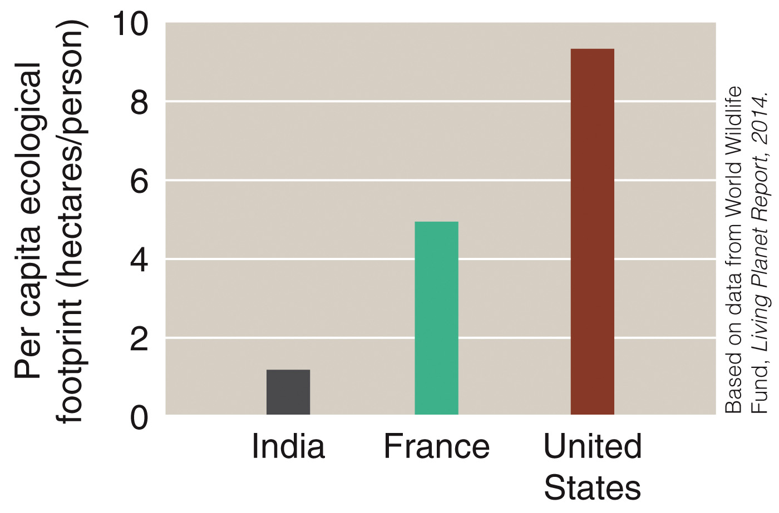
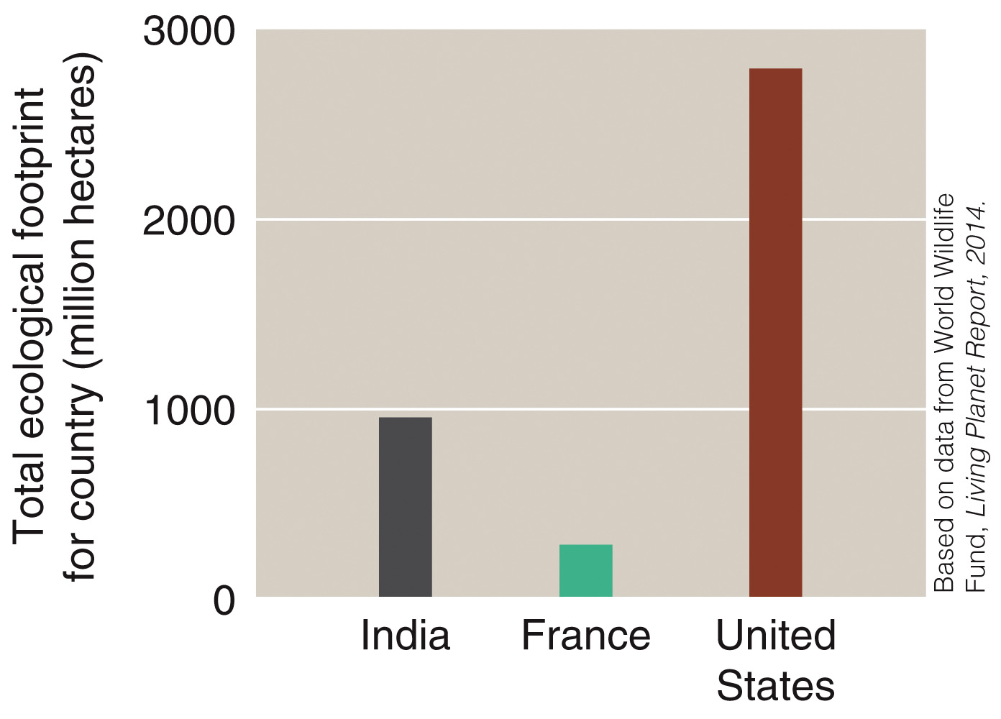
Population, Resources, and the Environment
Ecological footprints
The average ecological footprint of a person living in India, France, or the United States
The total ecological footprint for India, France, and the United States

Slide 14
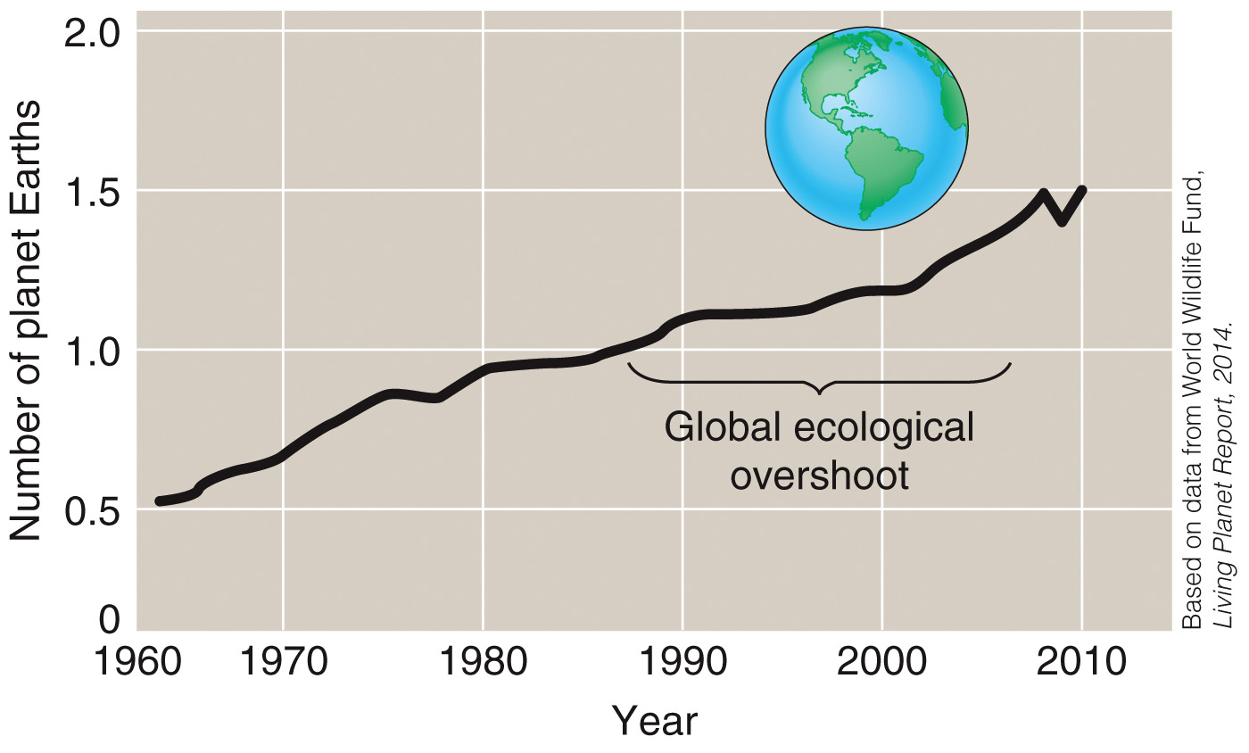
Population, Resources, and the Environment
Ecological footprints
Earth’s ecological footprint has been increasing over time. By 2010, humans were using the equivalent of 1.5 Earths, a situation that is not sustainable

Slide 15
Population, Resources, and the Environment
Population, consumption, and environmental impact
Human impacts on the environment are difficult to assess
Mathematical models are utilized which use three most important factors to determine environmental impact:
The number of people (P).
The affluence per person, which is a measure of the consumption, or amount of resources used per person (A).
The environmental effects (resources needed and wastes produced) of the technologies used to obtain and consume the resources (T).
This assessment method is known as the IPAT model:
I = P × A × T.

Slide 16
Sustainability and the Environment
Sustainability:
The ability to meet humanity’s current needs without compromising future generations’ ability to meet their needs
Based on several ideas
Economic, social, and environmental well being must all be considered
We must consider effects of our actions on the environment
Earth’s resources are finite
Understanding environmental and social costs of our consumption
All Earth’s inhabitants have shared responsibility for living sustainably

Slide 17
Sustainability and the Environment
Currently, human society is not operating sustainably, due to:
Use of nonrenewable resources as if they were unlimited
Use of renewable resources faster than they can be replenished
We are polluting the environment with toxins as if its capacity to absorb them was limitless
Population continues to increase
Human activities disrupt many natural regenerative processes
Left unchecked, these activities may make recovery of many depleted natural systems impossible
Solutions are complex and challenging
Ecological, social, and economic factors interact, making sustainability difficult to achieve

Slide 18
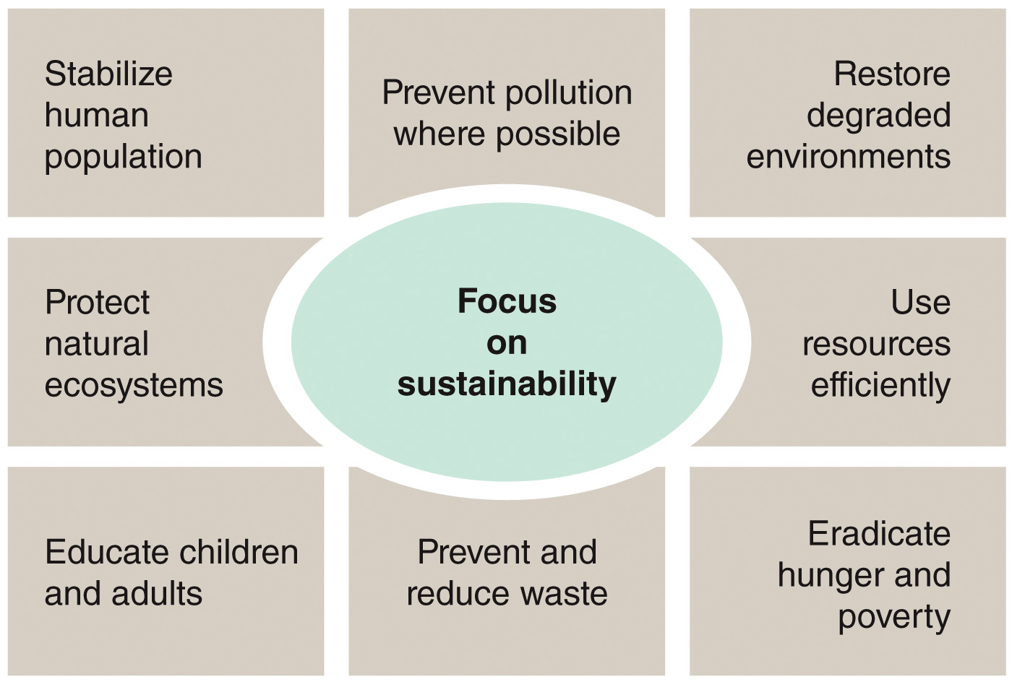
Sustainability and the Environment
Environmental sustainability requires a long-term perspective to promote economic, social, and environmental well-being, such as the goals shown here

Slide 19
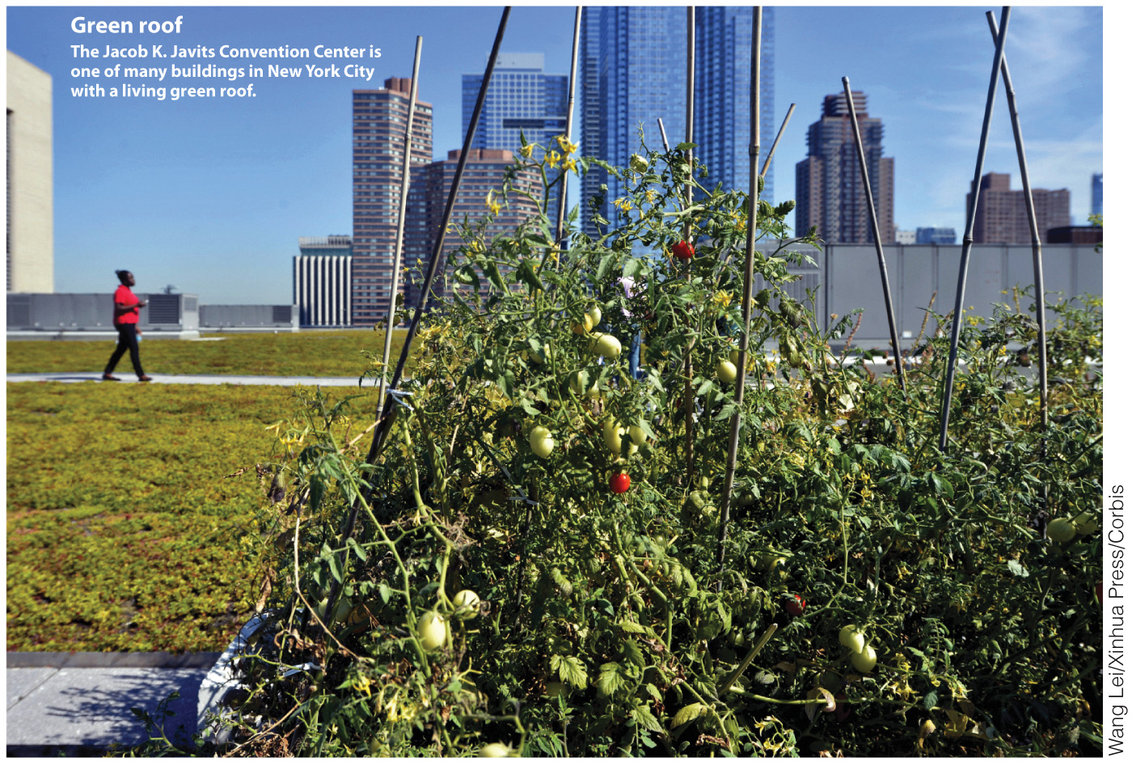
EnviroDiscovery: Green Roofs
Green roof: Partially or completely covered with vegetation and soil
Provide environmental benefits
Reduce heating costs in winter and cooling costs in summer
Filter rainwater pollutants
Reduce stormwater in sewers
Provide wildlife habitats
New York City has increasing numbers of green roofs

Slide 20
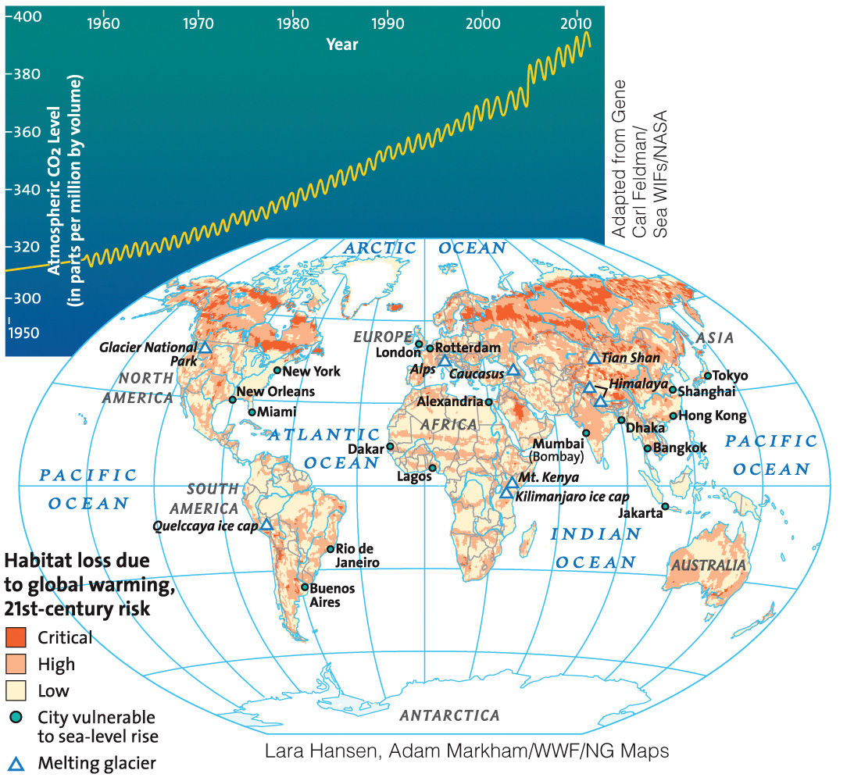
Global Environmental Issues
While climate variation is normal, global temperatures are increasing at an unprecedented rate
Climate is affected by human activities
Increased release of CO₂ and other greenhouse gases into the atmosphere
Industrial processes
Fossil fuel consumption
Deforestation
Land use change

Slide 21
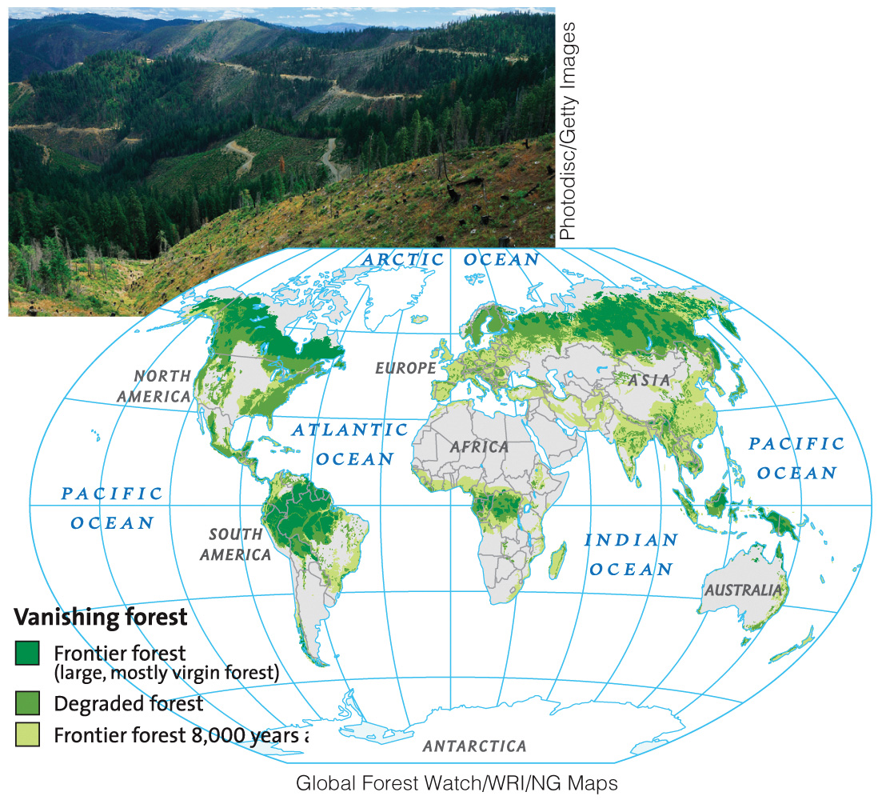
Global Environmental Issues
13 million hectares of forest lost annually
Loss of biodiversity
Loss of habitat for plants and animals
Deforested areas release CO₂ contributing to GCC
Deforestation affects local climates

Slide 22
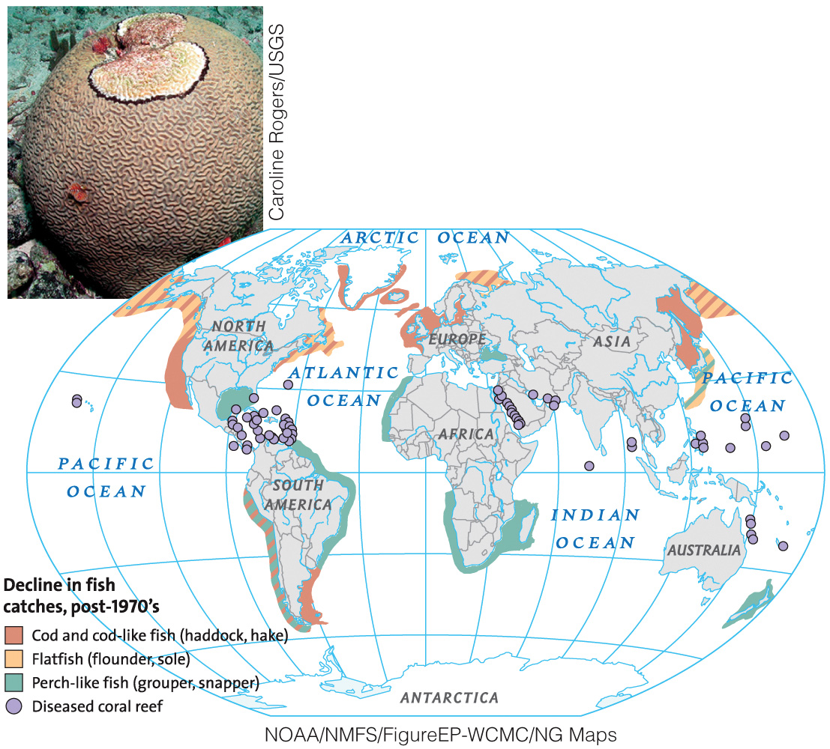
Global Environmental Issues
Oceans cover two-thirds of the Earth’s surface and are home to half of the world’s biodiversity
Over 70% of the world’s commercial fish species are depleted or nearing depletion
50% of coral reefs worldwide are threatened by human activity
Many factors cause ocean stresses
Overfishing
Pollution
Increased CO₂ emissions
Global climate change
Coastal development

Slide 23
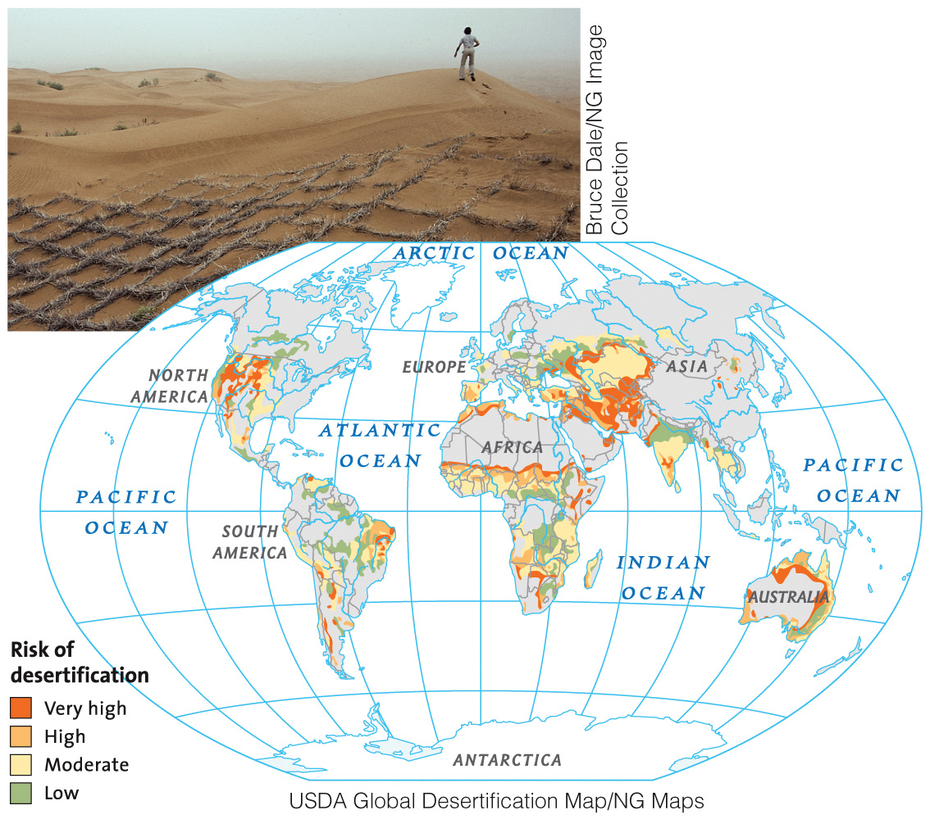
Global Environmental Issues
Animal grazing and land converted for agriculture are main causes of desertification
Desertification causes
Loss of topsoil
Increased soil salinity
Damaged vegetation
Regional climate change
Decline in biodiversity

Slide 24
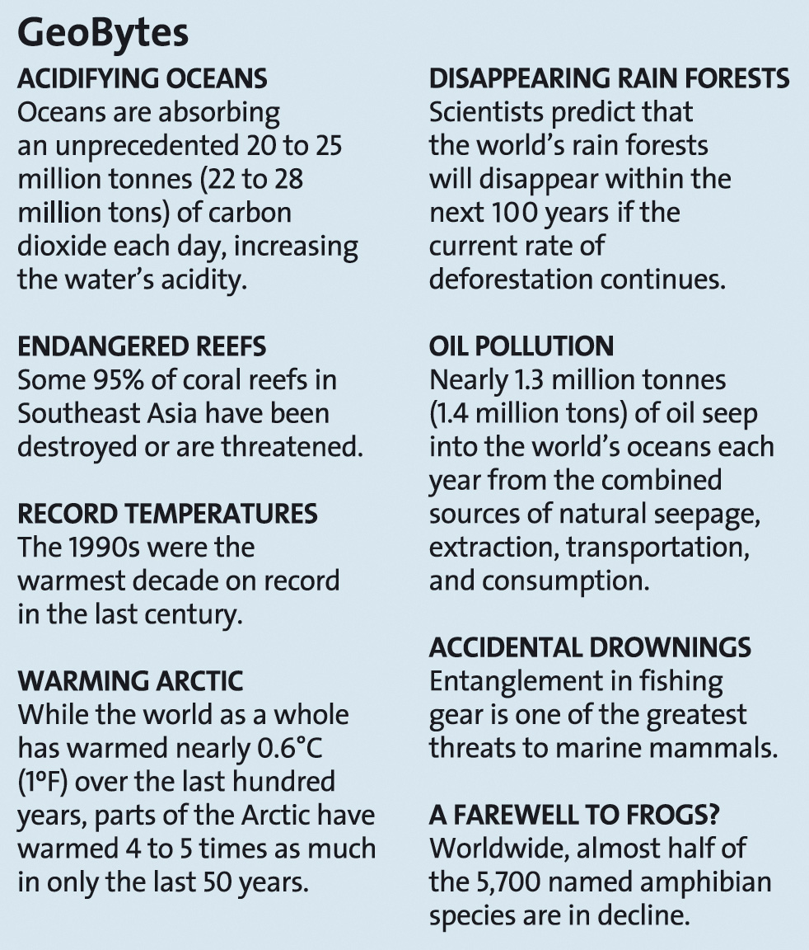
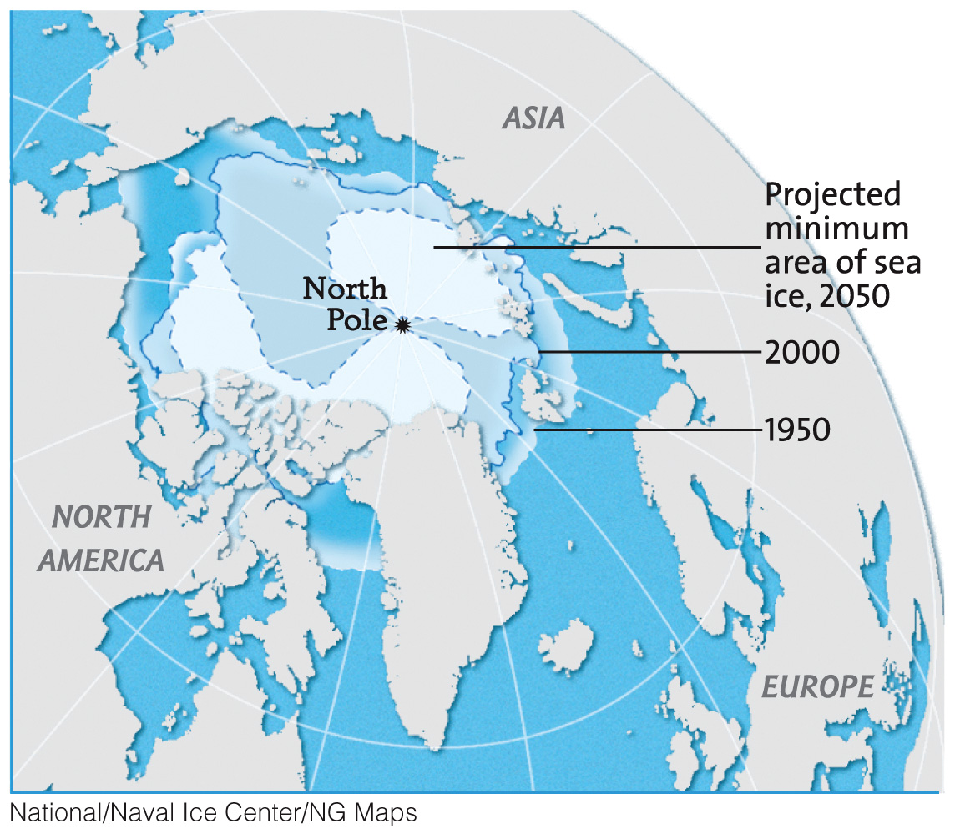
Global Environmental Issues
Polar ice cap melting at accelerated rate

Slide 25
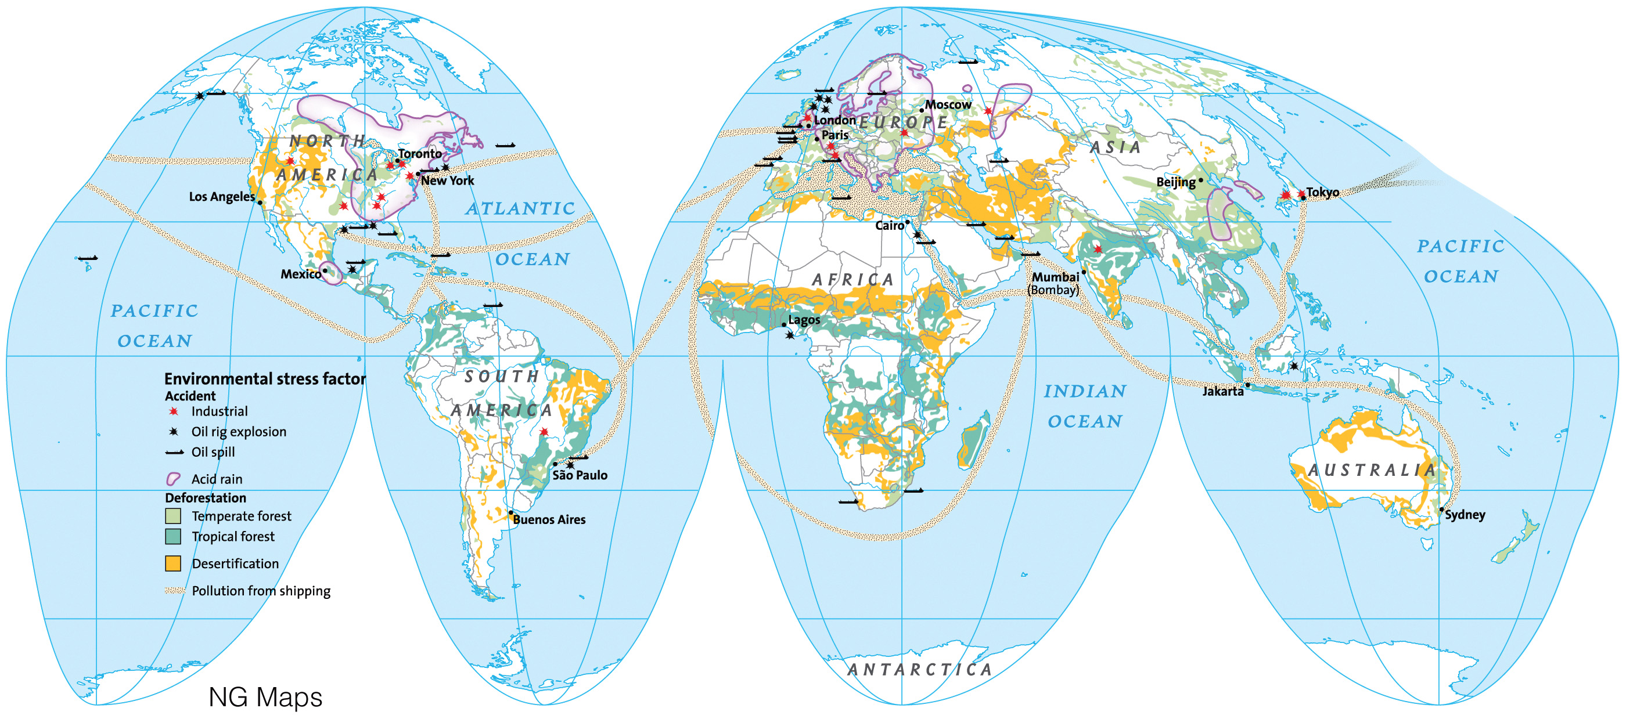
Global Environmental Issues
No corner of the earth is immune to pollution.

Slide 26
Global Environmental Issues
Ozone Depletion
First noticed in the mid-1980’s the springtime “ozone hole” over the Antarctic continues to grow. Restricting chlorofluorocarbons (CFCs) and other ozone depleting chemicals have begun to level the rate of depletion. Stratospheric ozone shields the Earth from the sun’s ultraviolet radiation. Thinning of this protective layer can have devastating effects on Earth’s biological functions.

Slide 27
Environmental Science
Interdisciplinary study of humanity’s relationship with other organisms and the physical environment
Combines information from many fields
Biology, physics, geology, geography, chemistry, economics, sociology (including demography), cultural anthropology, agriculture, engineering, law, politics, and ethics.
Ecology is a basic tool of environmental science
The study of interrelationships between organisms and the environment
Atmospheric science
Environmental chemistry
Geosciences

Slide 28
The Goals of Environmental Science
Establish general principles about how the natural world functions
Develop viable solutions to environmental problems
Identify, understand, and solve problems that we as a society have created
Focus on solving problems based on scientific knowledge

Slide 29
Science as a Process
Solutions to environmental problems require comprehensive scientific information and evaluation
Science is a body of knowledge AND a systematic process
Science involves data collection and analysis/interpretation
Science is not based on faith, emotion, or intuition
Scientific observations and experiments must be repeatable and produce consistent data to be considered valid
Careful scrutiny by other scientists always part of the scientific process
Scientific understanding changes over time, as new experiments and new data are undertaken and gathered

Slide 30
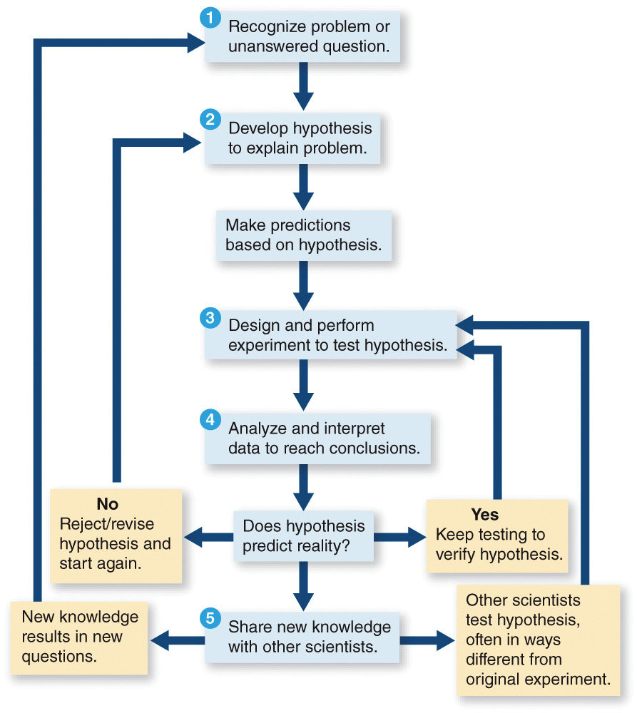
Science as a Process
The Scientific Method:
The way a scientist approaches a problem, by formulating a hypothesis and then testing it
Five steps (see chart)

Slide 31
Science as a Process
The importance of prediction:
Scientists formulate hypotheses based on what they think to be true based on prior scientific work
Hypotheses are predictions that can be tested by experimentation
Try to test one variable at a time and hold other constant
Experimental group vs. control group
May lead to a theory
Theories are an integrated explanation of numerous hypotheses
Each included hypothesis is supported by many observations and experiments
Theories clarify and simplify our understanding of the natural world
Unfortunately, many environmental science questions are not able to be formulated as testable hypotheses

Slide 32
How We Handle Environmental Problems
There are five stages in addressing environmental problems
Scientific assessment
Risk analysis
Public engagement
Political considerations
Long-term environmental management

Slide 33
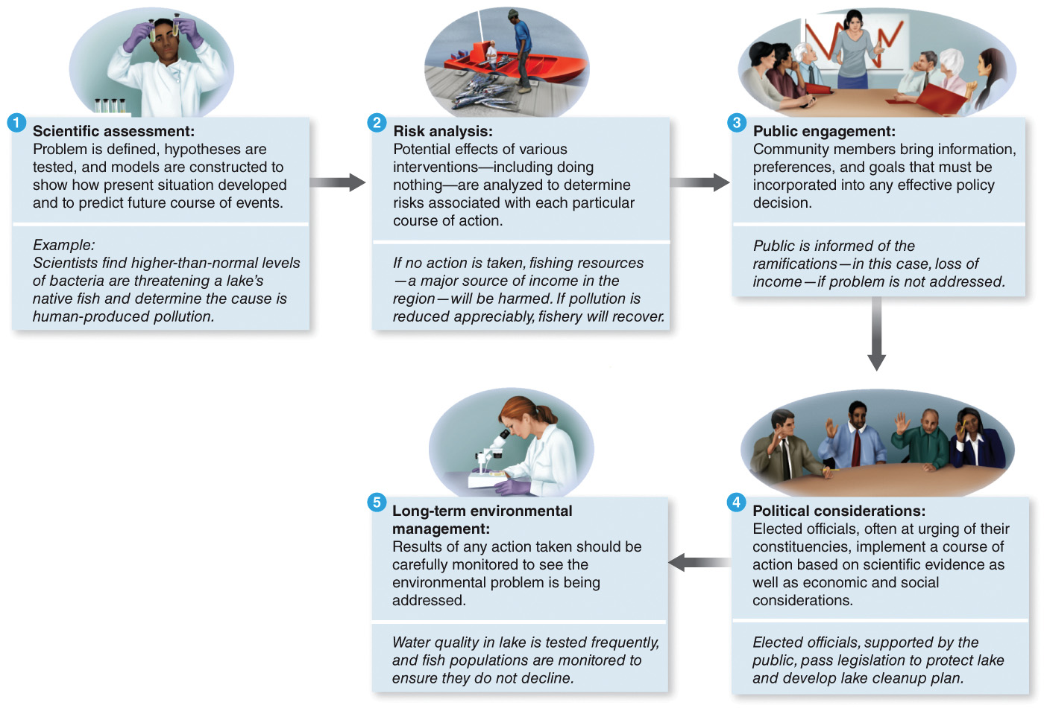
How We Handle Environmental Problems

Slide 34
EnviroDiscovery: NIMBY
NIMBY = Not In My Back Yard
Waste disposal sites are always controversial
Hazardous or dangerous waste sites are especially difficult to site
Frequent failure by developers and public planners to engage residents in decision-making process
Yucca Mountain in Nevada
Nuclear waste
More sophisticated approaches to waste disposal siting necessary in future

Slide 35
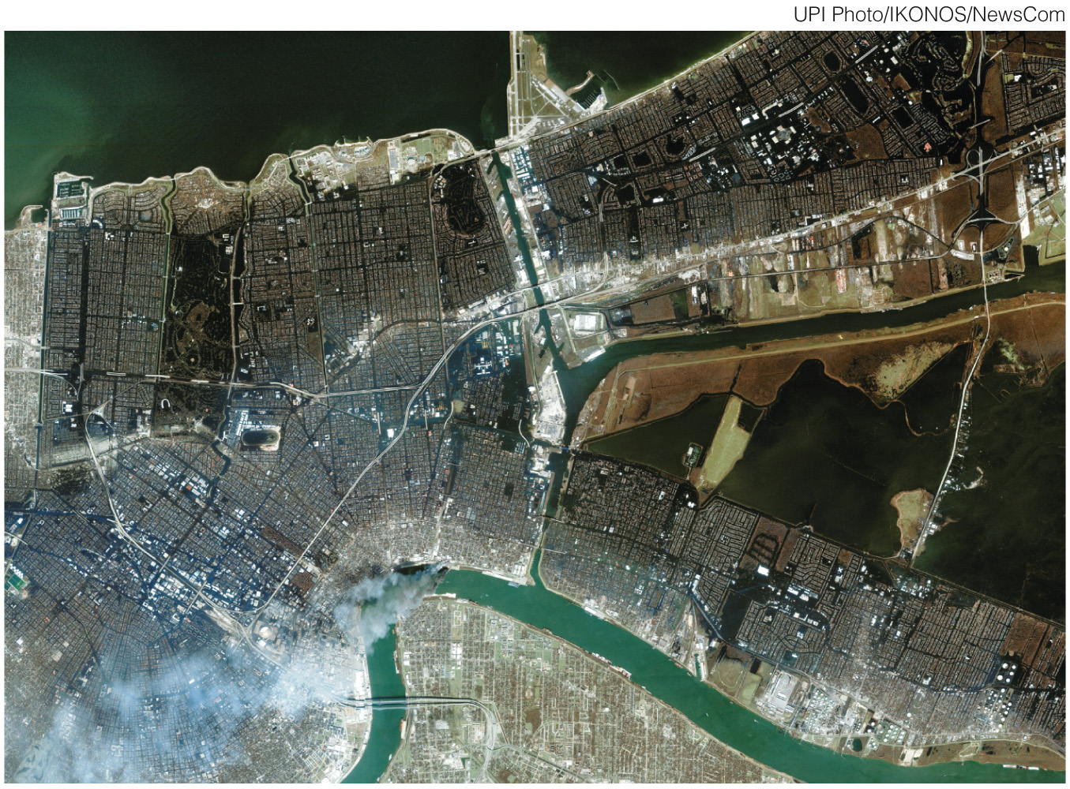
Case Study: The New Orleans Disaster
Hurricane Katrina, August 2005
Increased damage due to human alteration of the natural landscape
Man-made canals facilitated salt water killing marsh vegetation
Levees prevented sediment deposition
Settlements were built on drained wetlands
New Orleans sinking due to lack of bedrock, resulting from resource removal
This satellite image shows flooding in New Orleans following Hurricane Katrina. Along the left (west) side is a levee from Lake Pontchartrain (top) that failed so that water inundated the New Orleans area east of the levee. Areas on the far left top remained dry. Part of the Mississippi River is shown at lower center.

